Slide 1
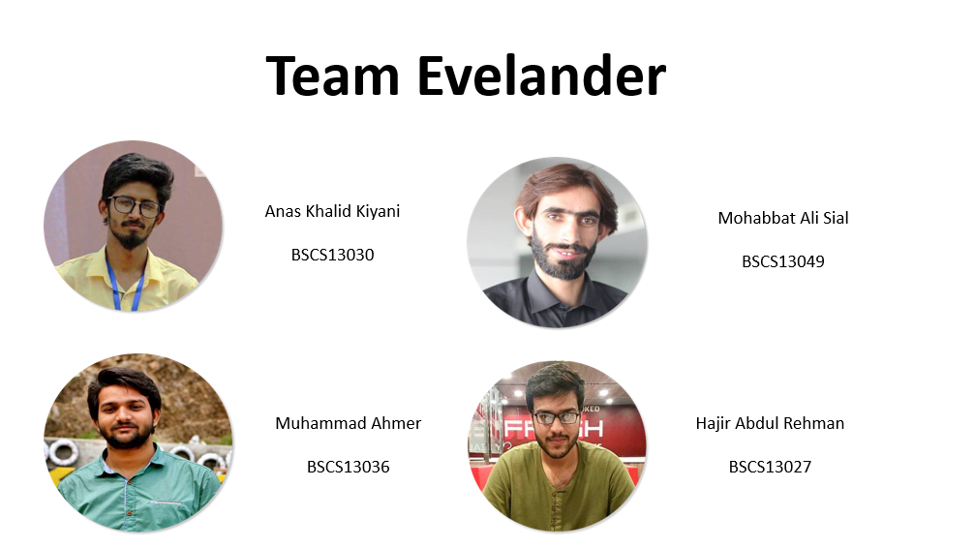

Slide 2
Value Proposition
Three Tasks
Video Storyboards

Slide 3
Value Proposition
Three Tasks
Video Storyboards

Slide 4
Value Proposition: “Managing events made easier”
Everyday there are events taking place all around you, we miss many of those interesting events as there isn’t any platform specifically for managing events. We hope to solve this problem by introducing an App that can list all of your favorite events happening around you. You can mark your favorite events, choose your favorite categories, get notifications about any updates, buy tickets and can contact the organizer directly.

Slide 5
Value Proposition
Three Tasks
Video Storyboards

Slide 6
Value Proposition
Three Tasks
Video Storyboards

Slide 7
Three Tasks
Simple:
You want to go to an event.
Medium:
You find events happening around you.
Complex:
You get notifications and updates about your favorite events.

Slide 8
Value Proposition
Three Tasks
Video Storyboards

Slide 9
Value Proposition
Three Tasks
Video Storyboards

Slide 10
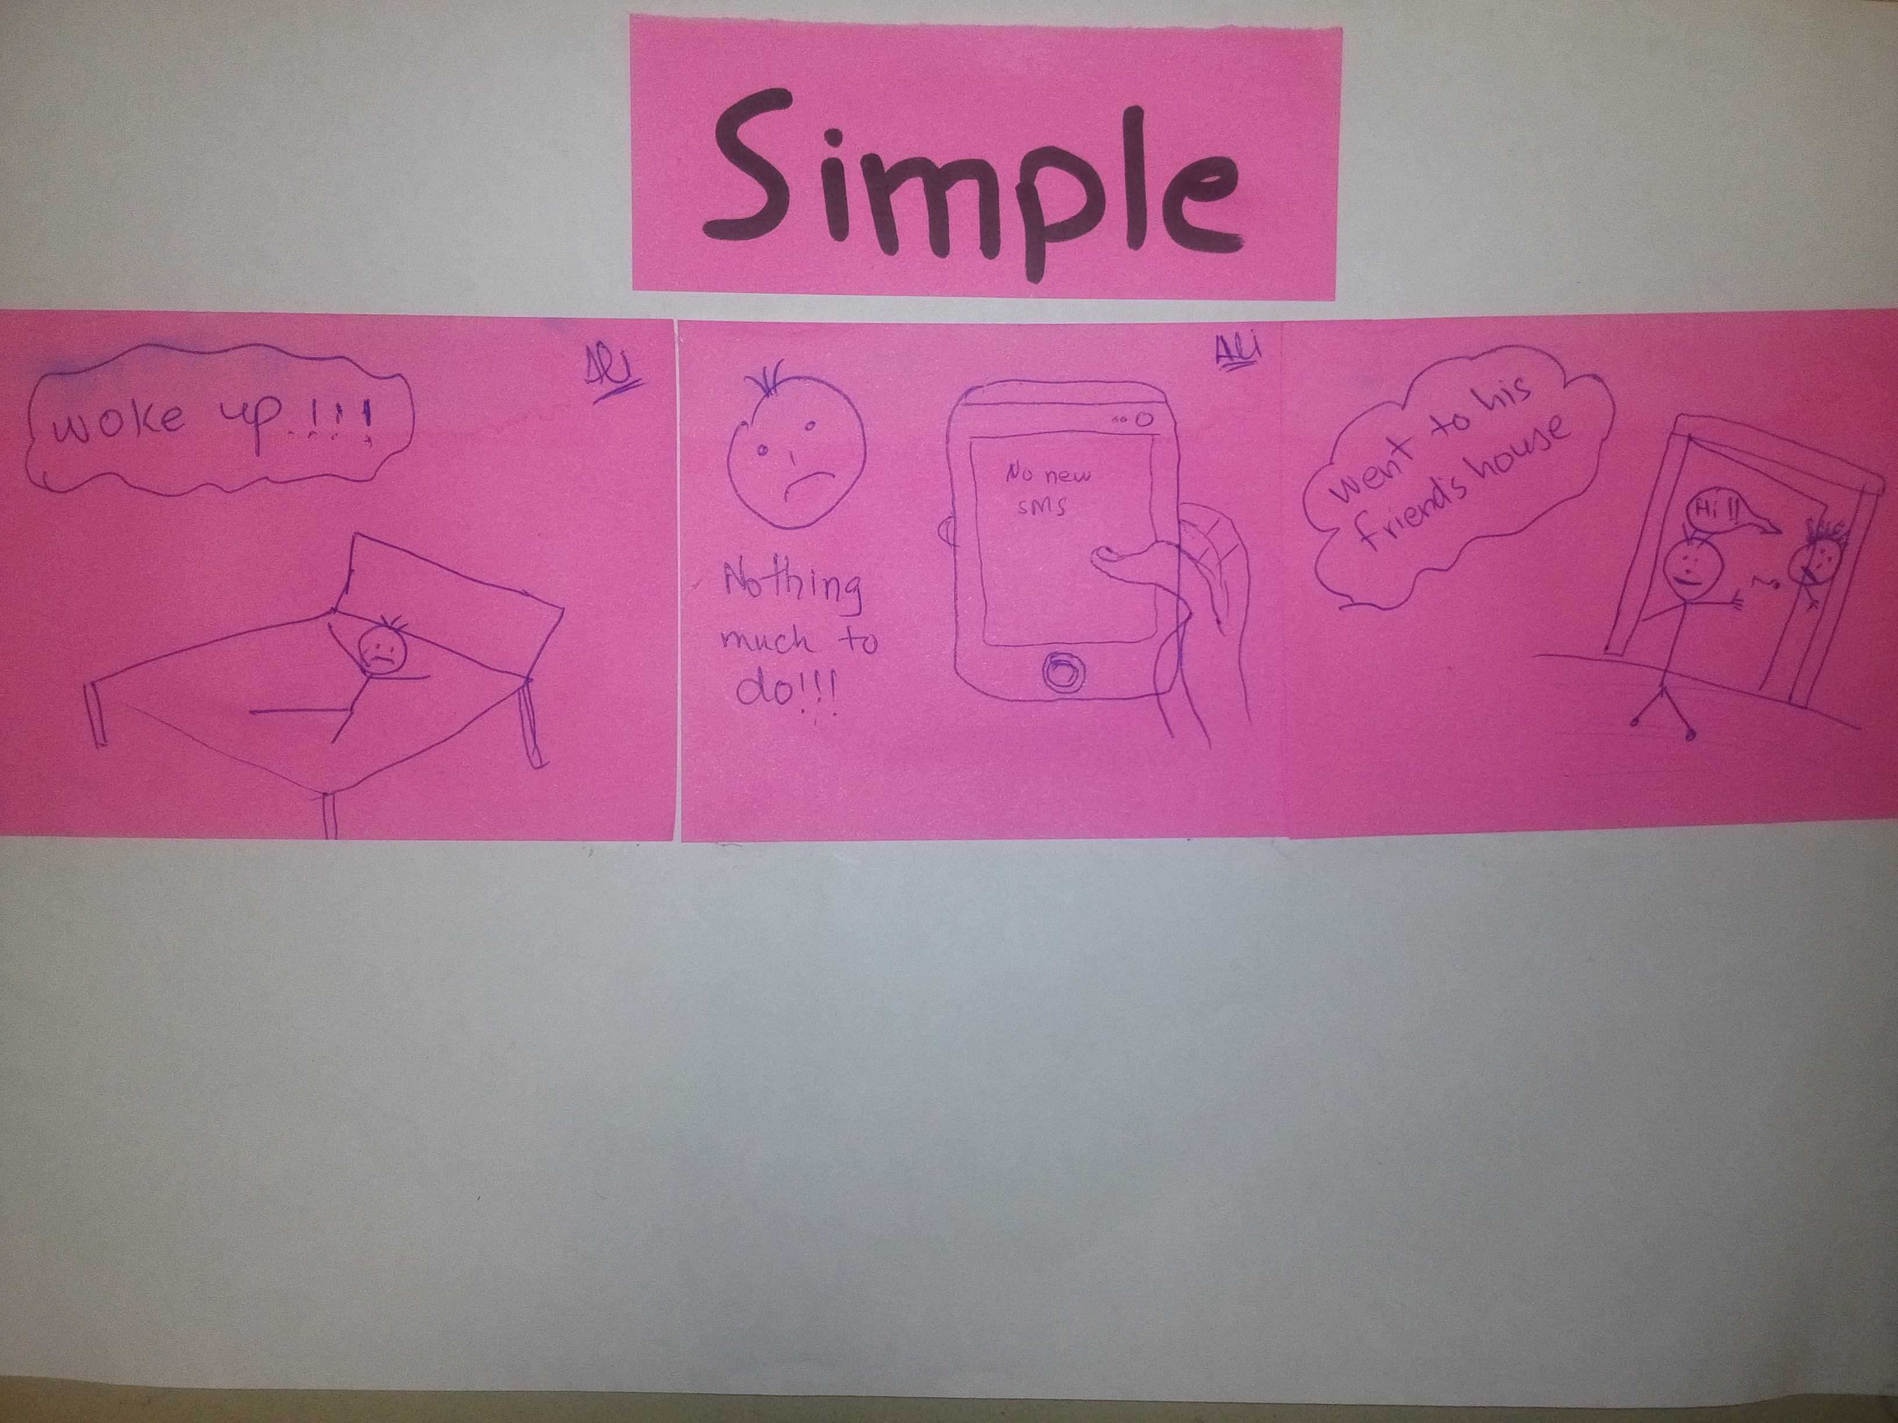

Slide 11
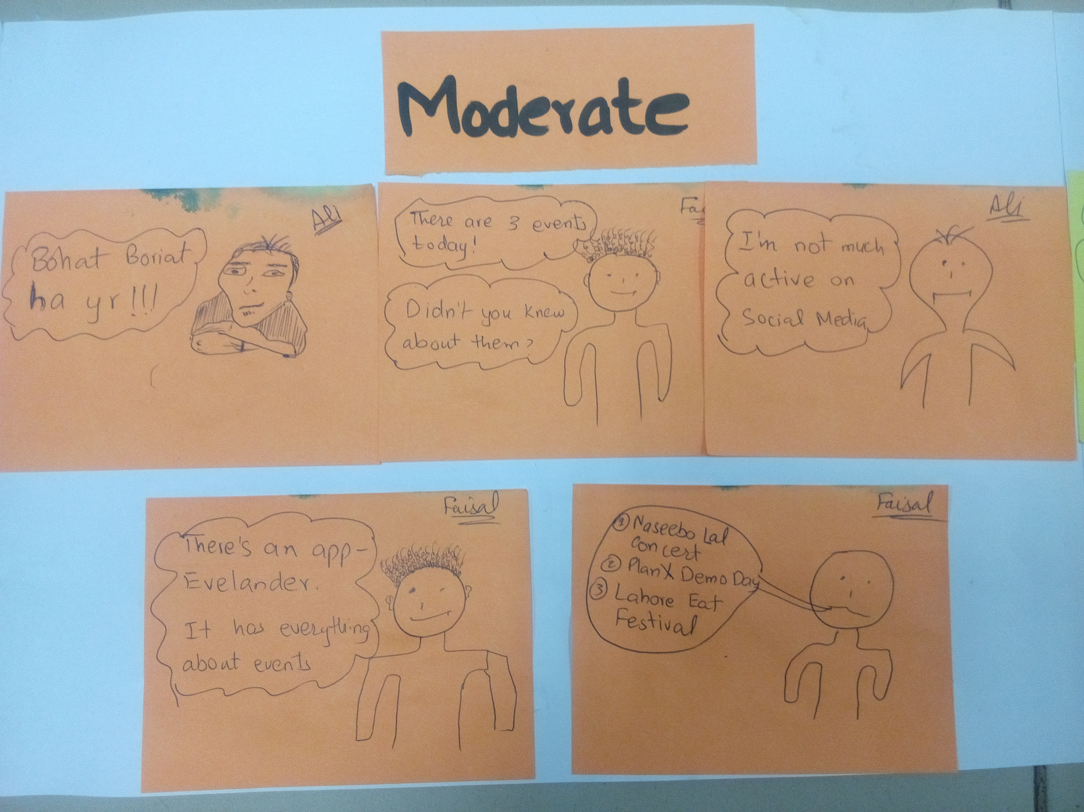

Slide 12
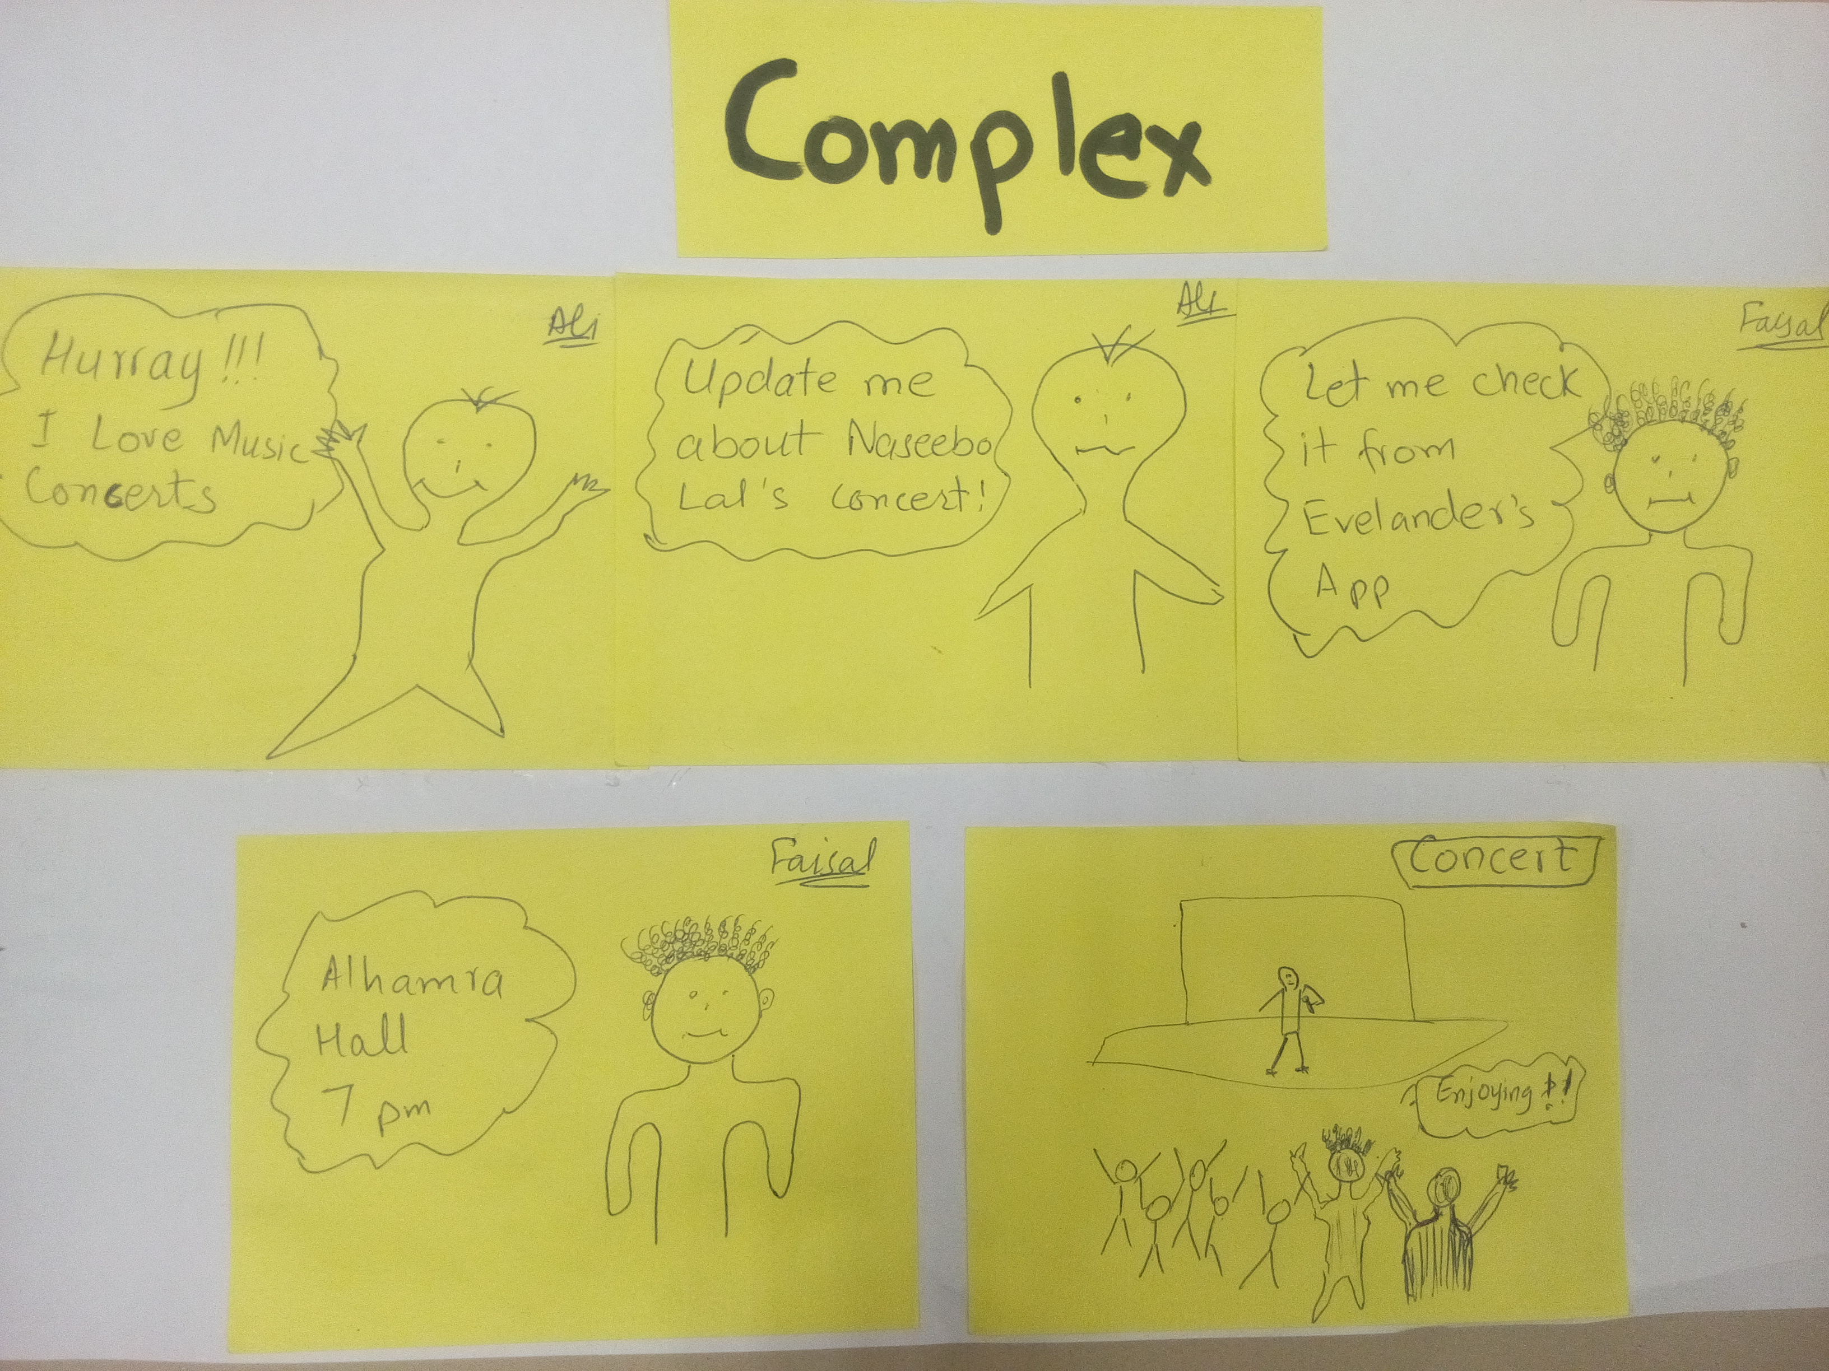

Slide 13
Video Link
https://www.youtube.com/watch?v=SbmDdp5Dxlc

Slide 14
Questions?

